Slide 1

Multi-Robot Reinforcement Learning Review
Mustafa Kağan Aytaç
Fadime Yaren Durmuş

Slide 2

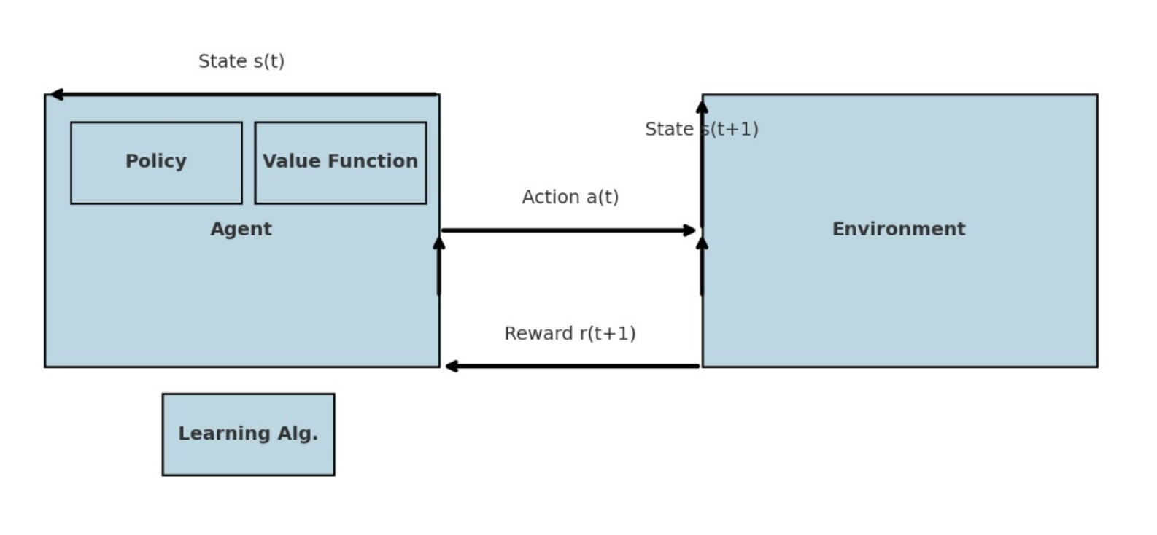

Slide 3
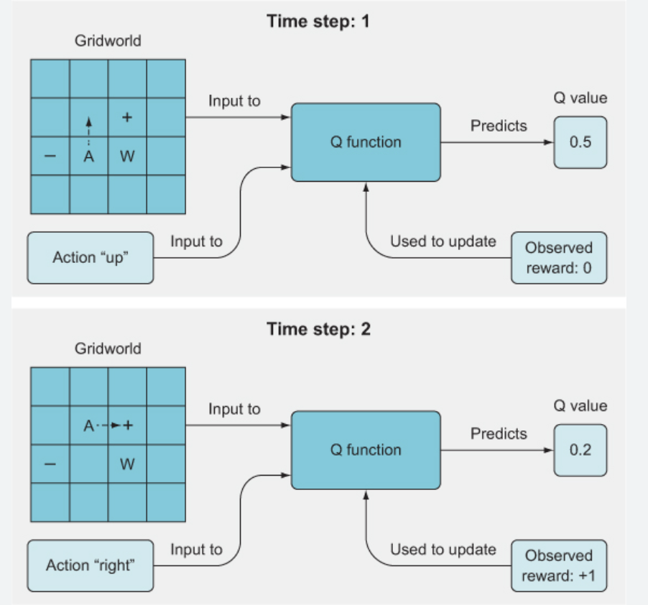


Slide 4
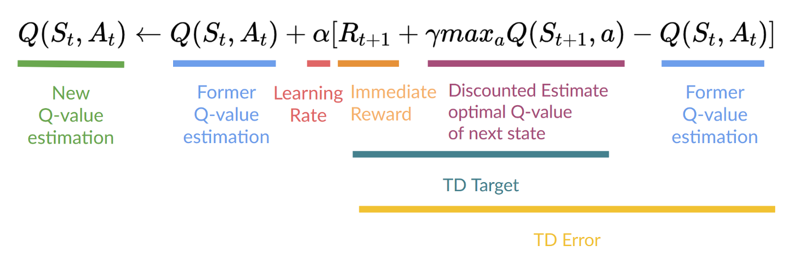
Q-Learning
Q-Table and Q-Values

Slide 5
Q-Table Step by step Explanation

Slide 6
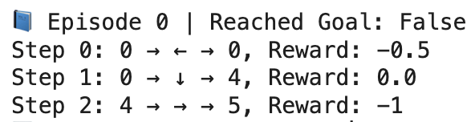
before
States | Left | Bottom | Right | Up
0 | 0 | 0 | 0 | 0
1 | 0 | 0 | 0 | 0
2 | 0 | 0 | 0 | 0
3 | 0 | 0 | 0 | 0
4 | 0 | 0 | 0 | 0
5 | 0 | 0 | 0 | 0
6 | 0 | 0 | 0 | 0
7 | 0 | 0 | 0 | 0
8 | 0 | 0 | 0 | 0
9 | 0 | 0 | 0 | 0
10 | 0 | 0 | 0 | 0
11 | 0 | 0 | 0 | 0
12 | 0 | 0 | 0 | 0
13 | 0 | 0 | 0 | 0
14 | 0 | 0 | 0 | 0
15 | 0 | 0 | 0 | 0
Episode 0
after
States | Left | Bottom | Right | Up
0 | -0.15 | 0 | 0 | 0
1 | 0 | 0 | 0 | 0
2 | 0 | 0 | 0 | 0
3 | 0 | 0 | 0 | 0
4 | 0 | 0 | -0.3 | 0
5 | 0 | 0 | 0 | 0
6 | 0 | 0 | 0 | 0
7 | 0 | 0 | 0 | 0
8 | 0 | 0 | 0 | 0
9 | 0 | 0 | 0 | 0
10 | 0 | 0 | 0 | 0
11 | 0 | 0 | 0 | 0
12 | 0 | 0 | 0 | 0
13 | 0 | 0 | 0 | 0
14 | 0 | 0 | 0 | 0
15 | 0 | 0 | 0 | 0
0 → 0 → 4→ 5
States
0. 1. 2. 3.
4. 5. 6. 7.
8. 9. 10. 11
12 13 14 15

Slide 7

Q(0,←)=0+0.3×(−0.5−0)=−0.15
Q(0,↓)=0+0.3×(0+0−0)=0
Q(4,→)=0+0.3×(−1−0)=−0.3

Slide 8
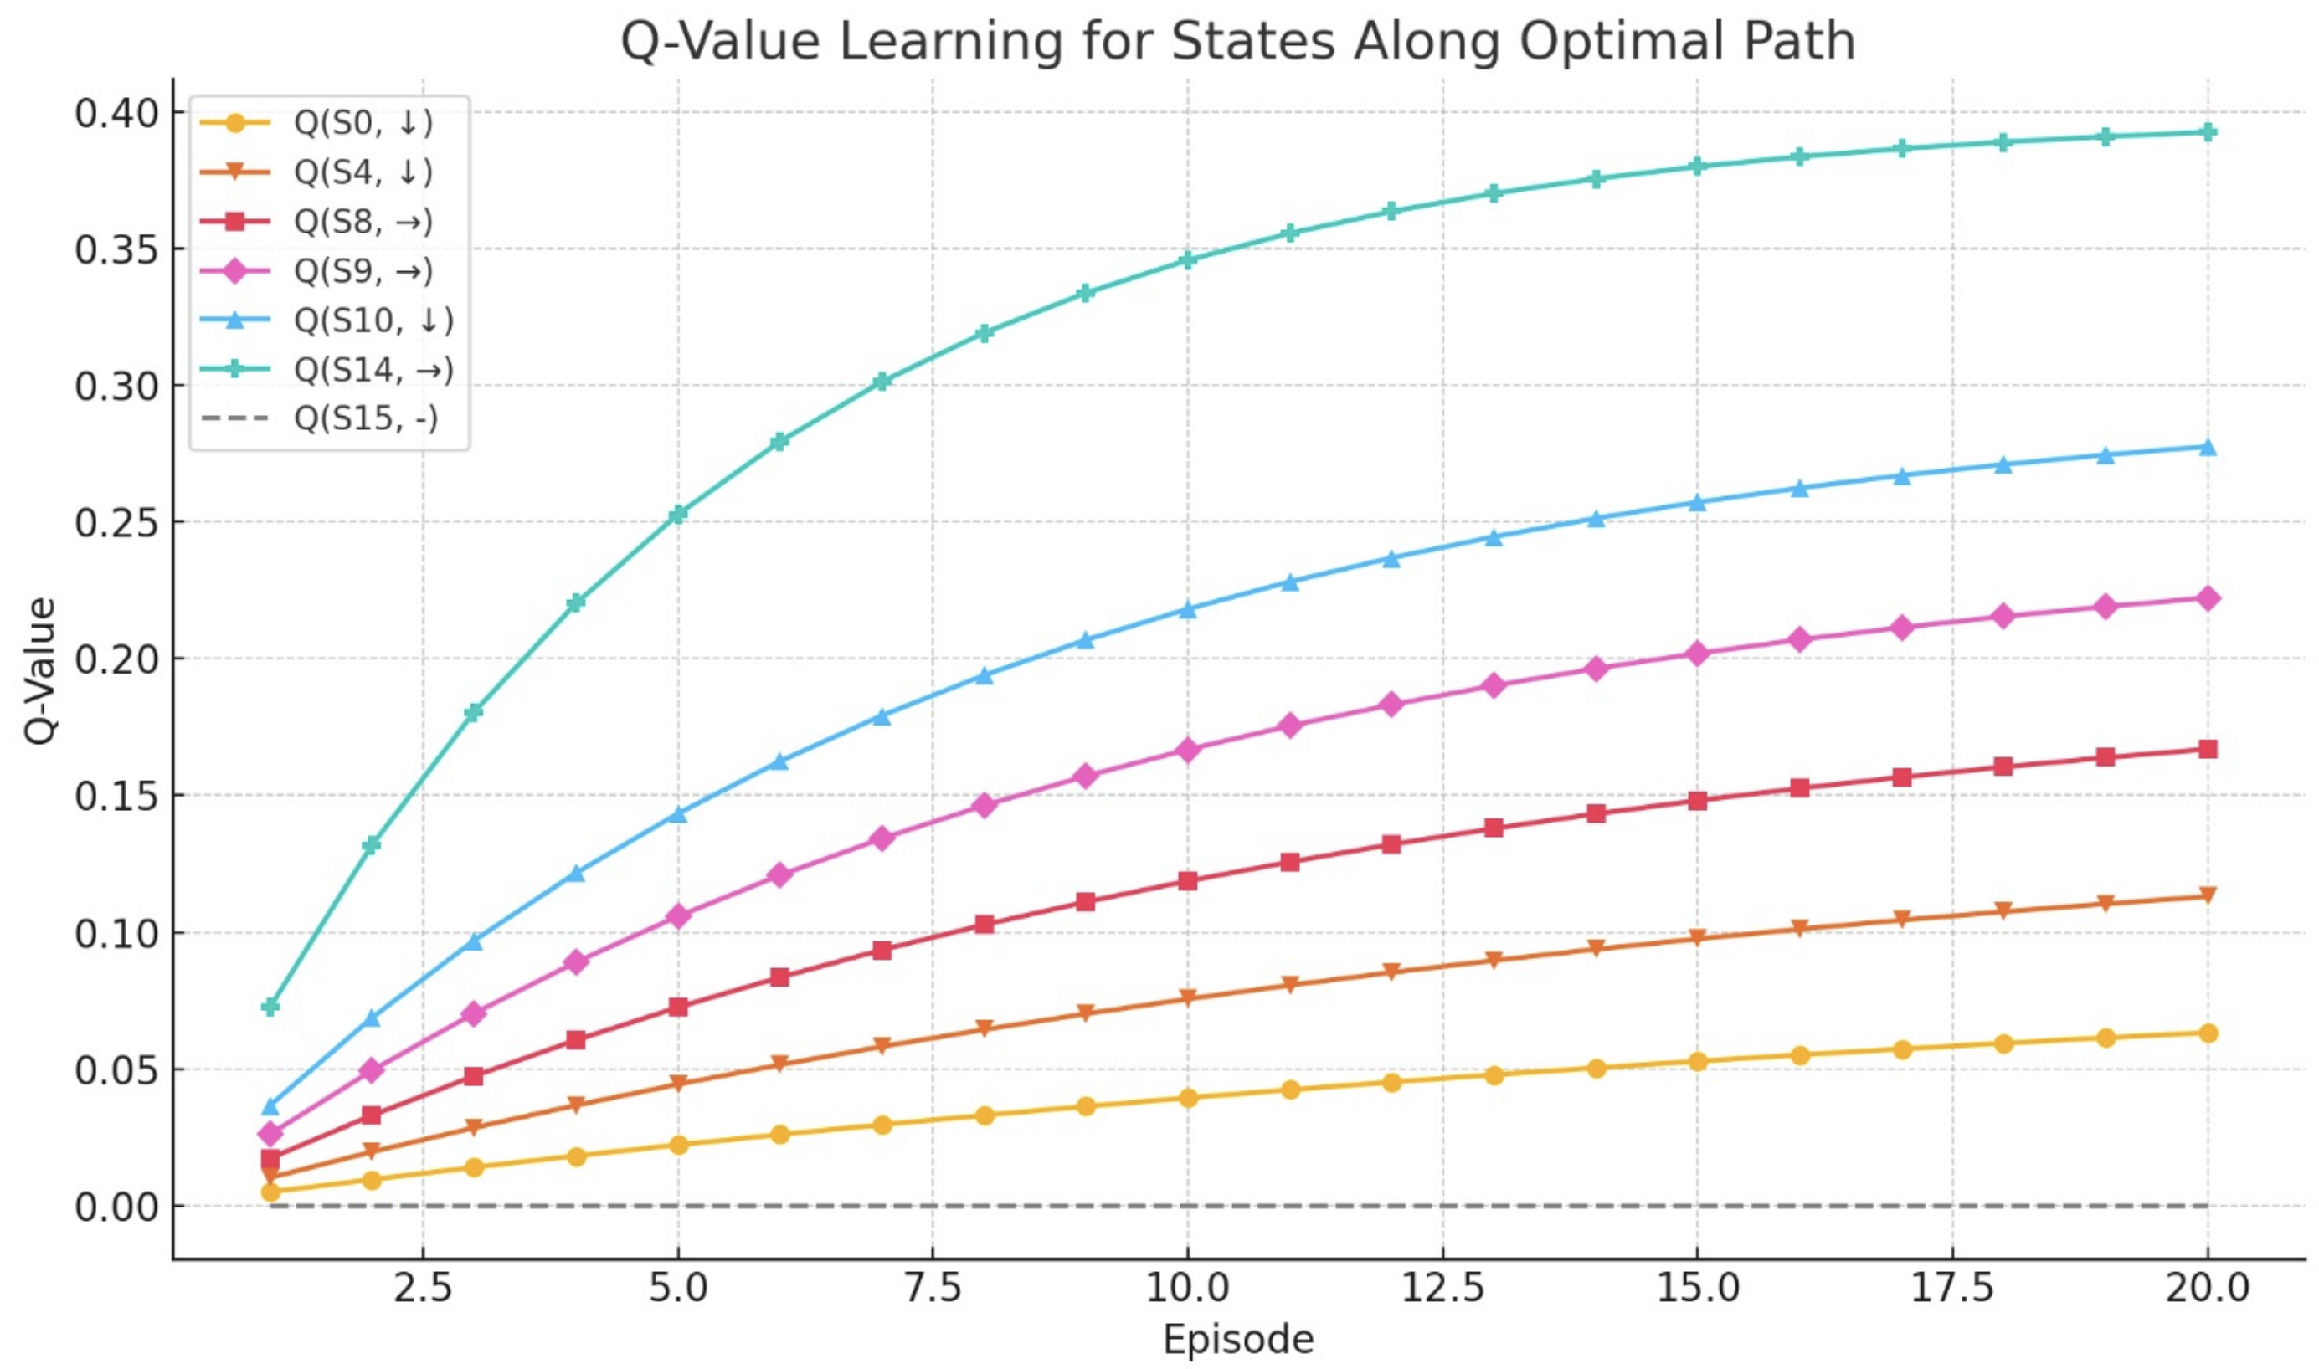

Slide 9
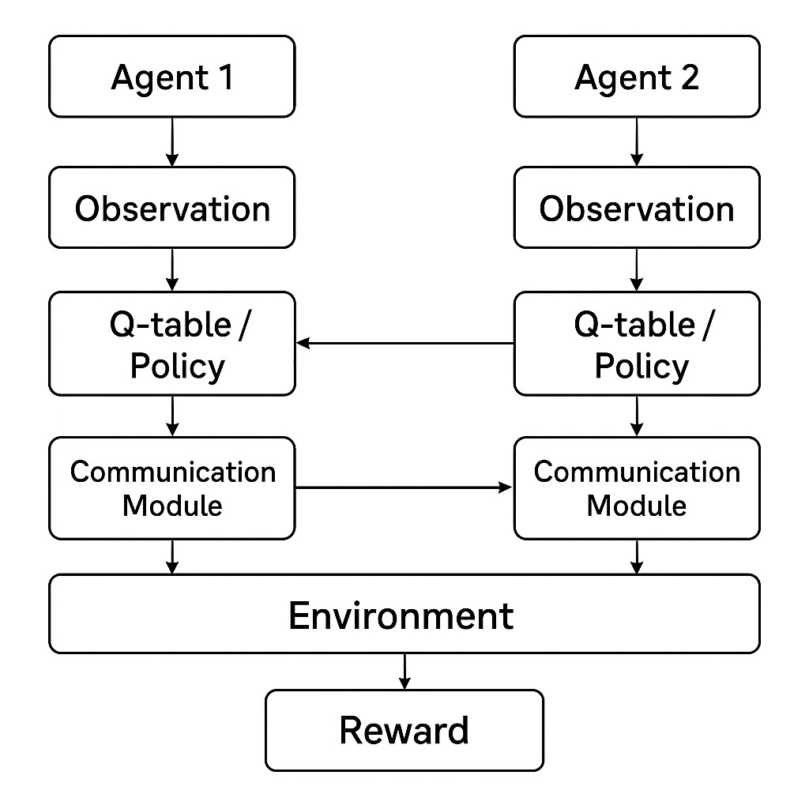

Slide 10
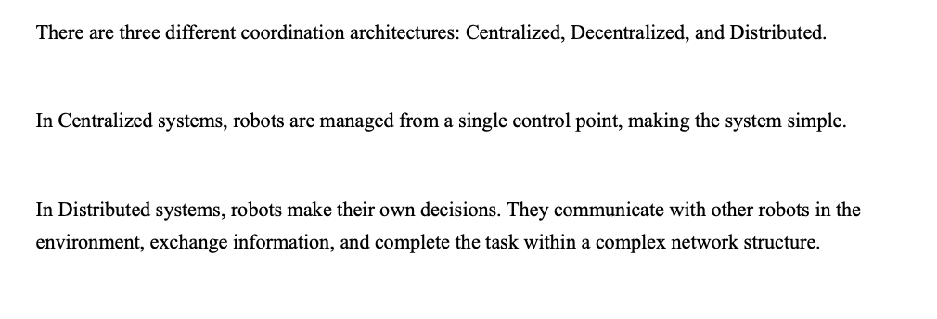
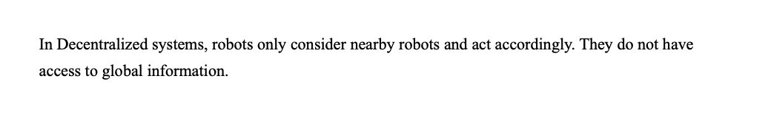

Slide 11
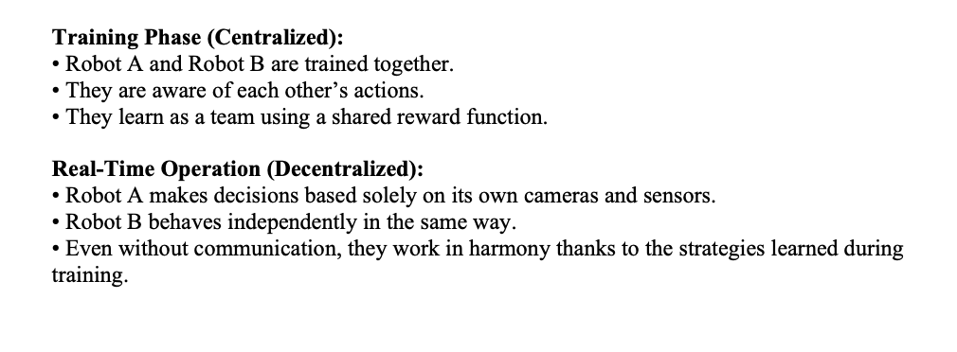

Slide 12
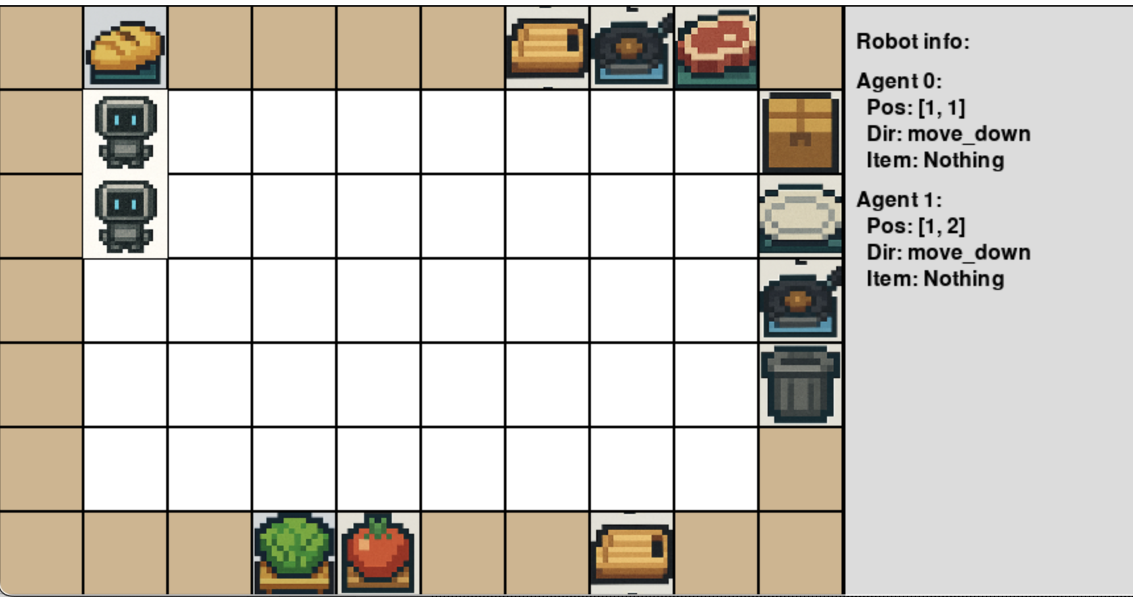

Slide 13
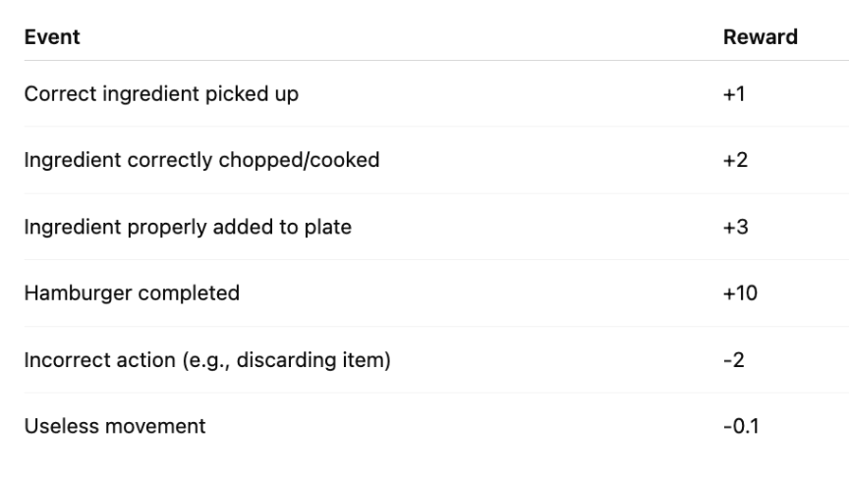

Slide 14
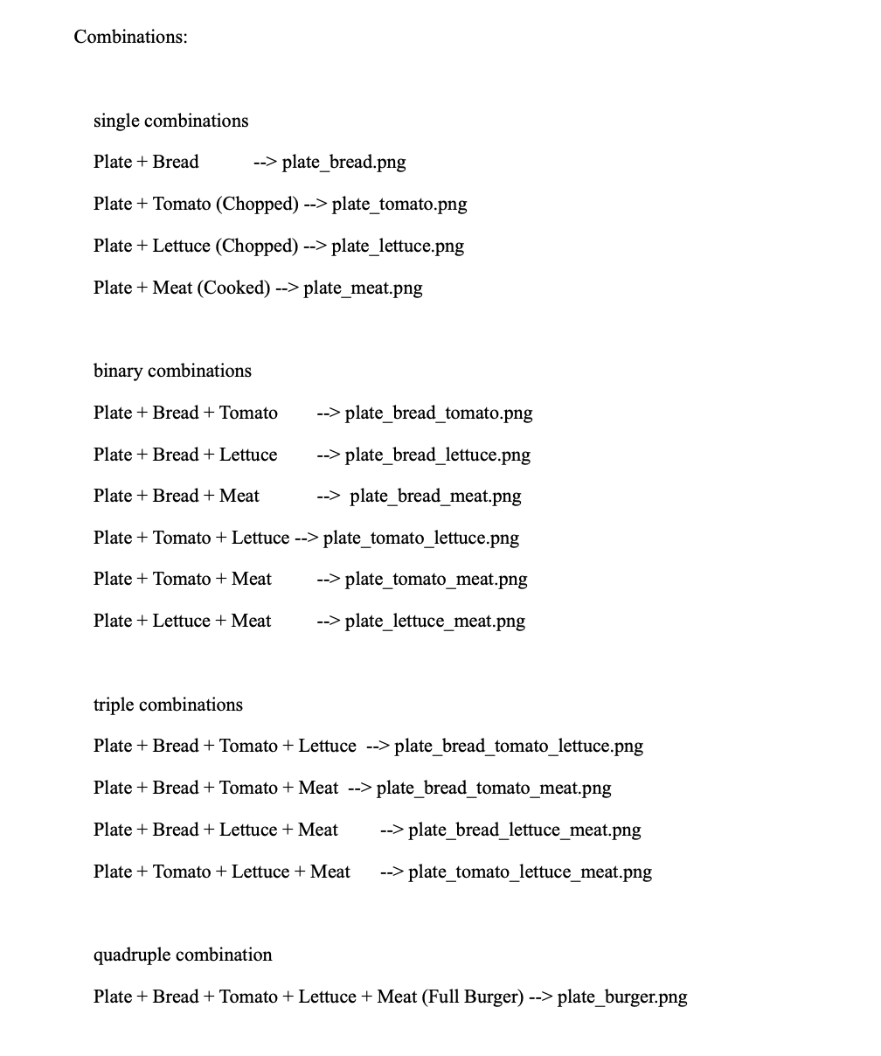

Slide 15
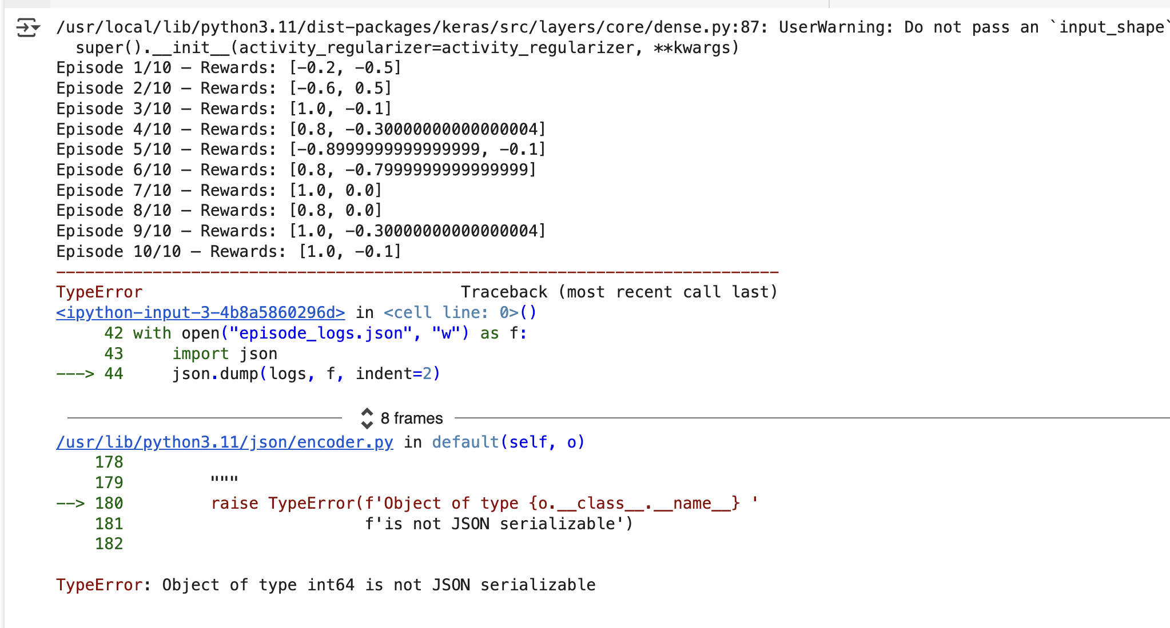
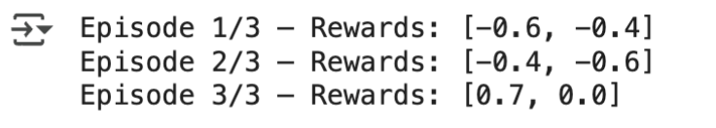
Some Results We Get When We Trying To Train Agents

Slide 16
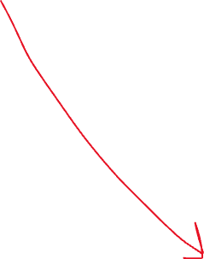




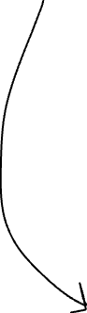
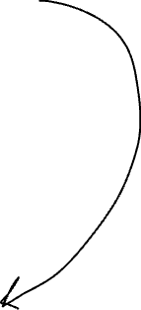


Q table for aget 1
Q table for aget 2
Qtotal​(s,a1​,a2​)=f(Q1​,Q2​,...,s)
If they work together they get more reward
Hamburger 1
Hamburger 2
So, if they work together total reward +40, if they work seperately total reward is +20

Slide 17
Thank You For Listening To Us

